Slide 1
Café Chain
Submitted by – Yash Saxena
PGP-DSBA-Blended –Jun’20

Slide 2

Exploratory Analysis and Executive Summary

Slide 3
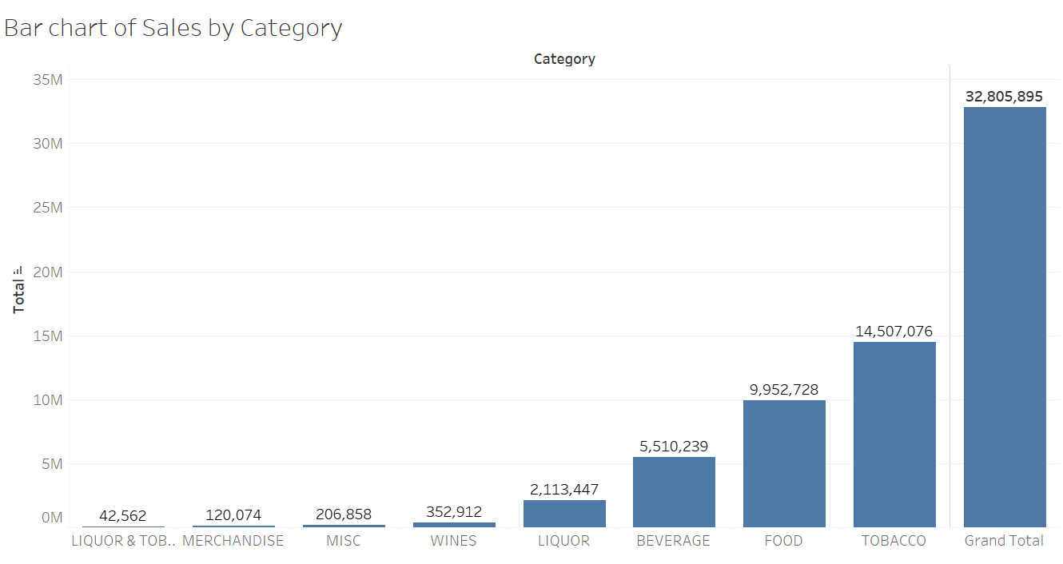
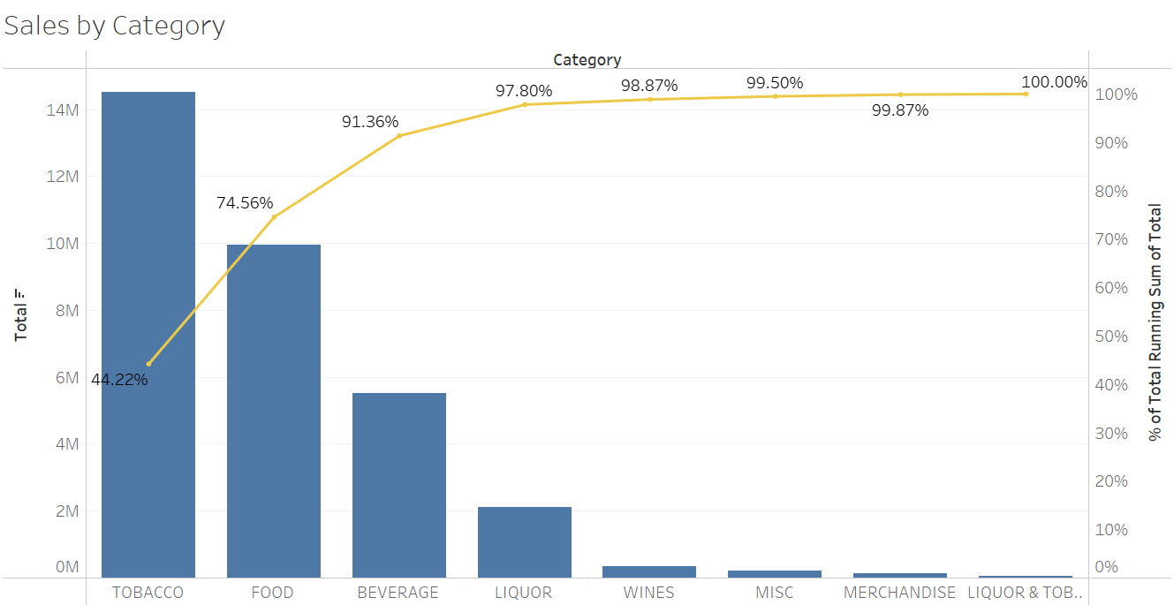
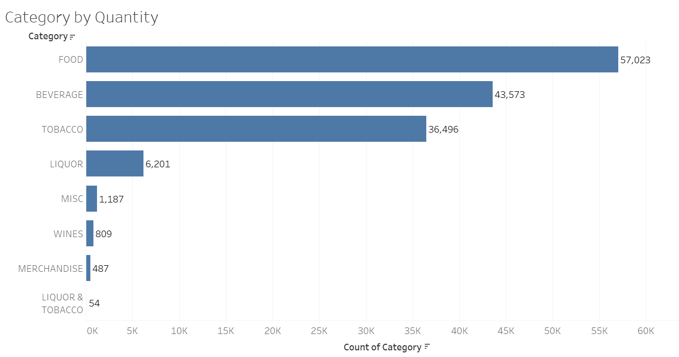
The total sales generated by the restaurant is 32,805,895
Tobacco is the highest selling category in terms of contributing 44.22% of the total sales
Food is the highest selling category in terms of quantity
91.36% of the total sales is contributed by Tobacco, Food, and Beverage

Slide 4
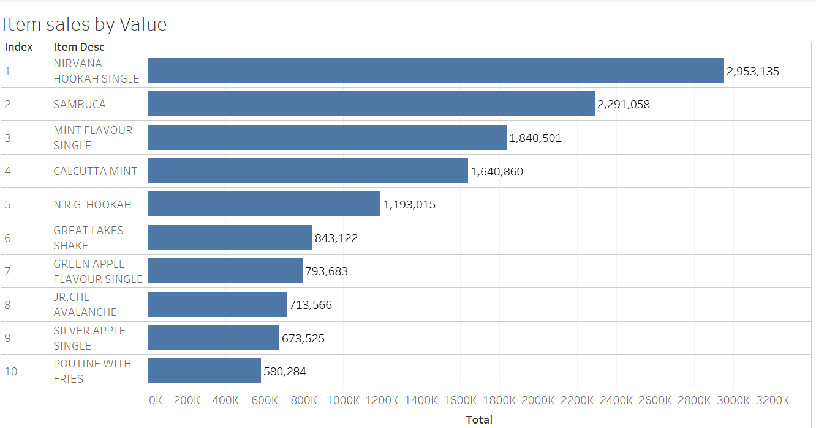
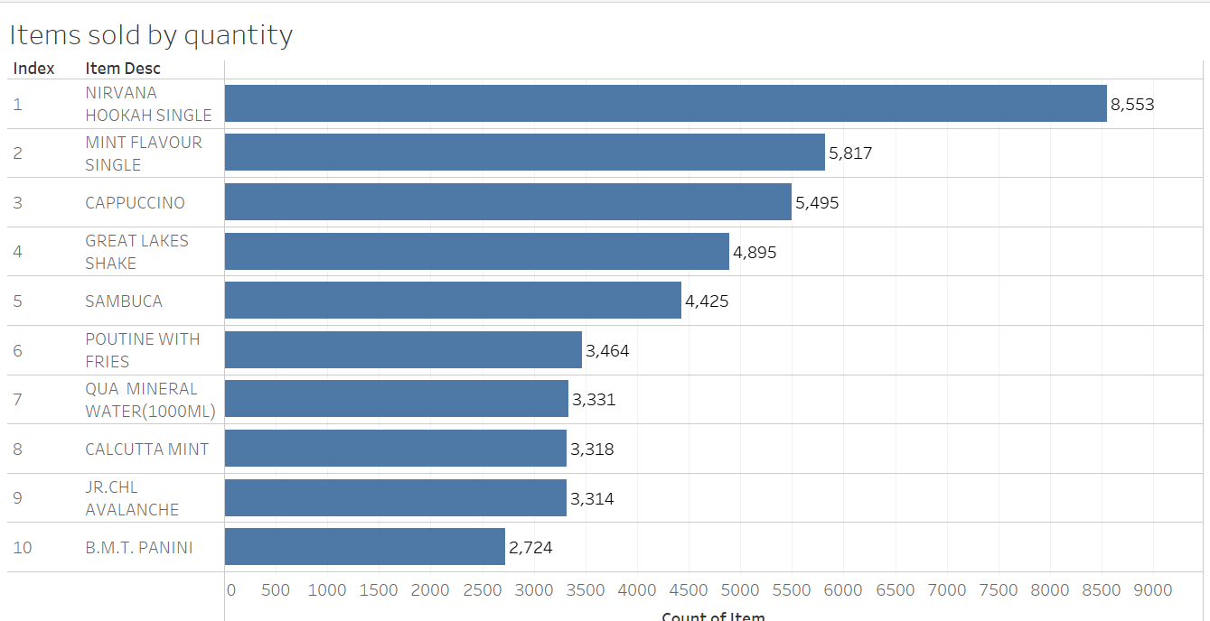
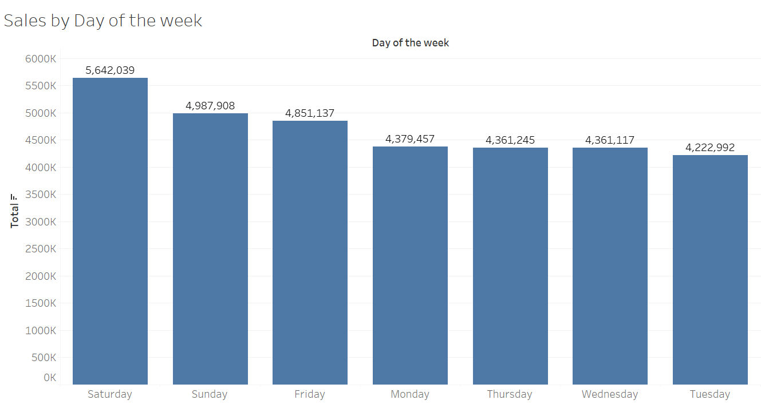
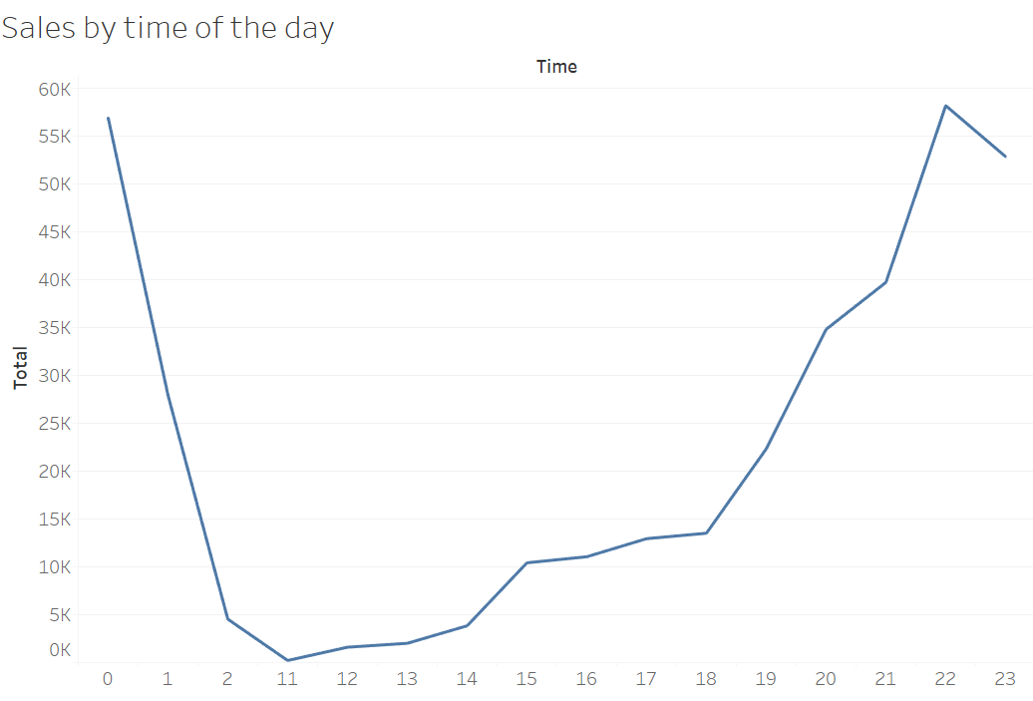
Nirvana Hookah Single is the highest selling item by value amounting to 2.95 Mn. Followed by Sambuca, Calcutta Mint, and NRG Hookah
Nirvana Hookah single is sold most in quantity amounting to 8553. Followed by Mint flavour single, Cappuccino, and Great lakes shake
Saturdays have seen the maximum sales of 5.64 million followed by 4.98 million total sales on Sunday
There is an uptick in sales after 6pm and it increases till 10pm

Slide 5
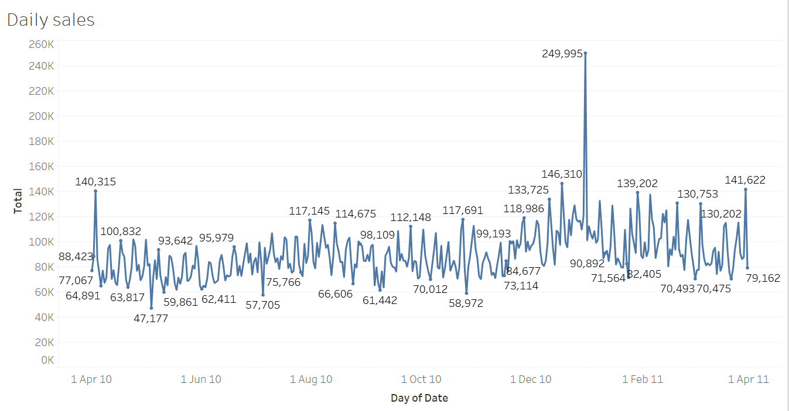
December is the month when maximum sales is seen. Particularly, Dec. 31st . Also, a couple weekends prior to Dec. 31st have also done well in sales

Slide 6
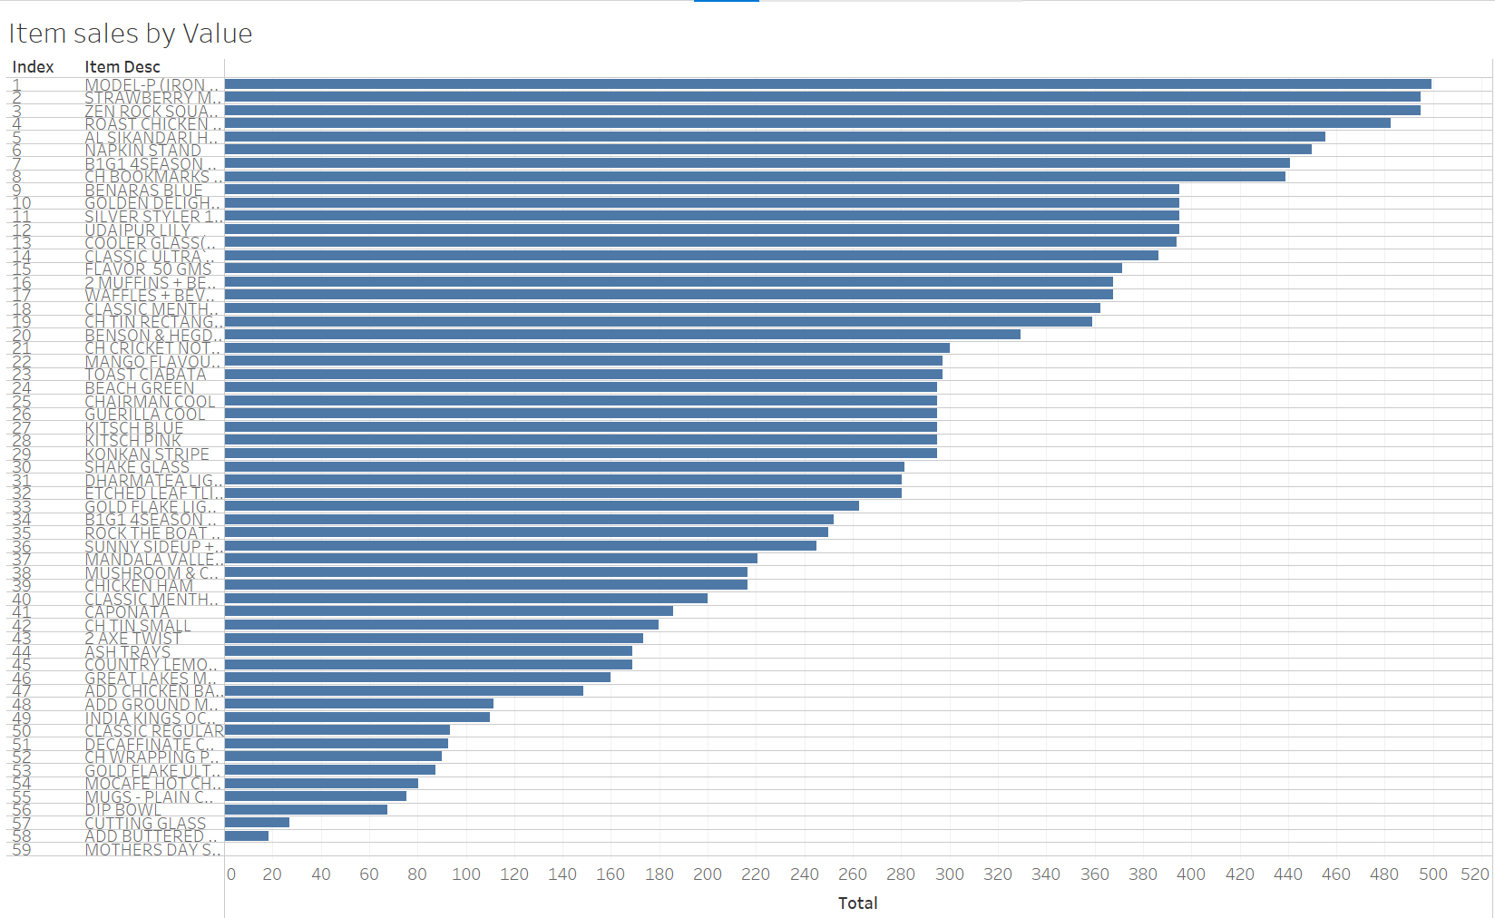
There are 59 items for which the total annual sales is less than 500
Most (30) items are from the Merchandise category

Slide 7

Consumer Behaviour

Slide 8
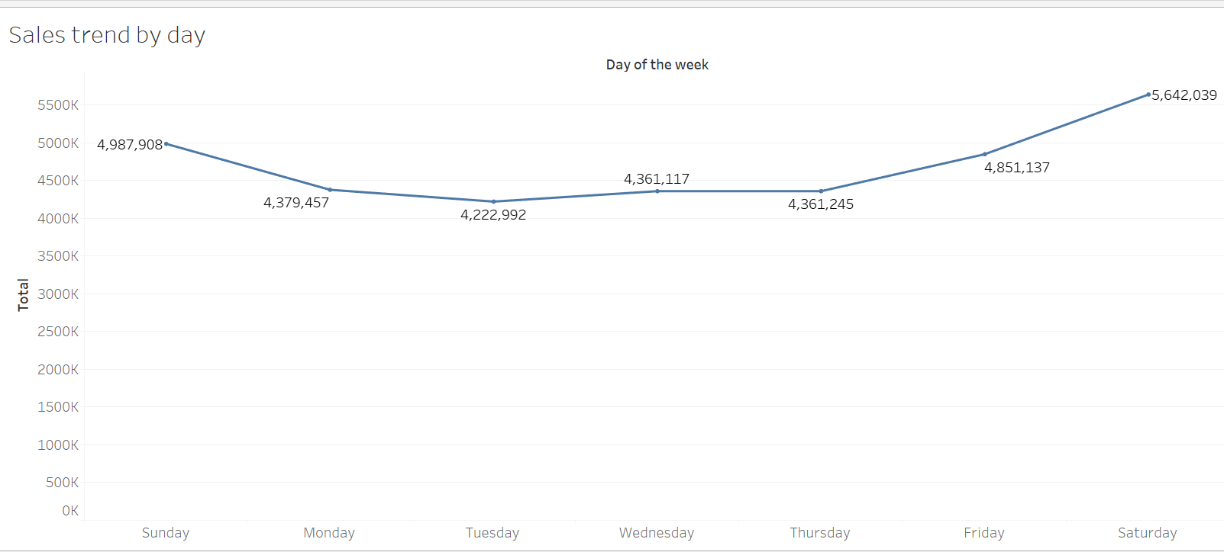
Sales trend by days of the week
The sales of items rise on Friday and is highest on Saturday. This may be due to the weekend effect

Slide 9
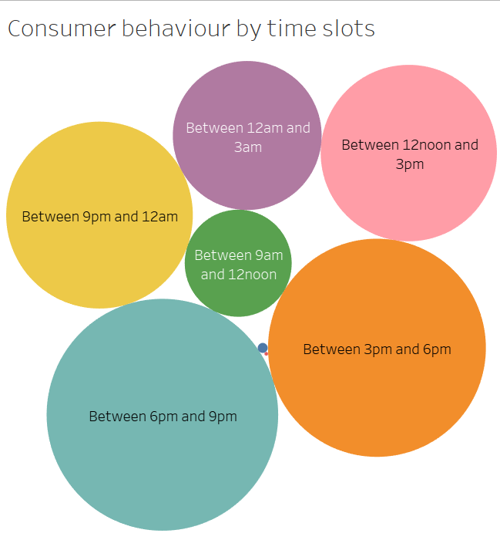
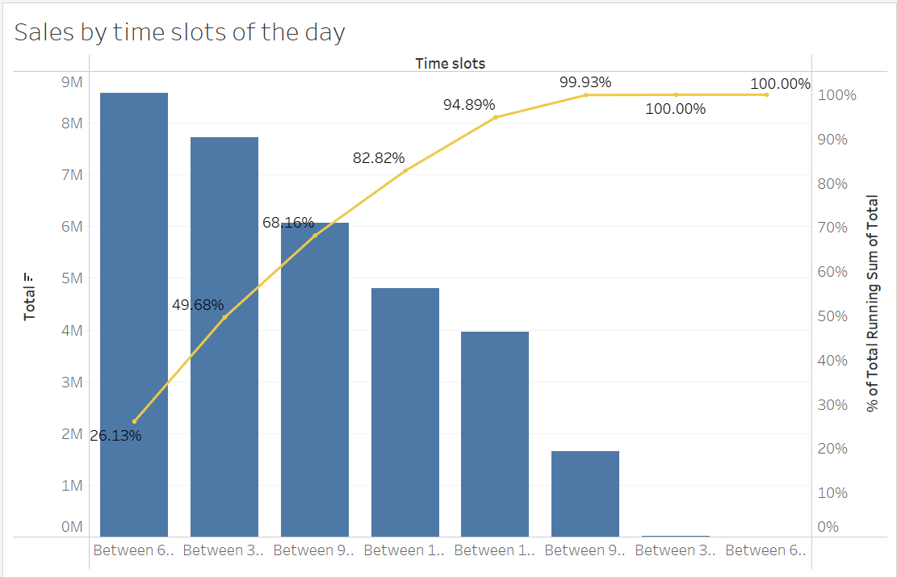
Sales trend by time of the day
About 50% of the total sales is made between 3pm to 9pm
Consumers prefer to have caffeine during 6am – 9am. Only beverages are being sold during this time with Red bull in majority. It could be beneficial to run an offer of Red Bull 2+1 or Red Bull 3+2 during this time. As Red Bull 2+1 is the second highest selling item by value in Beverage. See dashboard#1
Sales are being made between 3am and 6am on Friday and Saturday only. Maybe the store remains closed on other days. If not, some offers must be run on Sheesha products as they are being sold in majority. See Dashboard #2

Slide 10
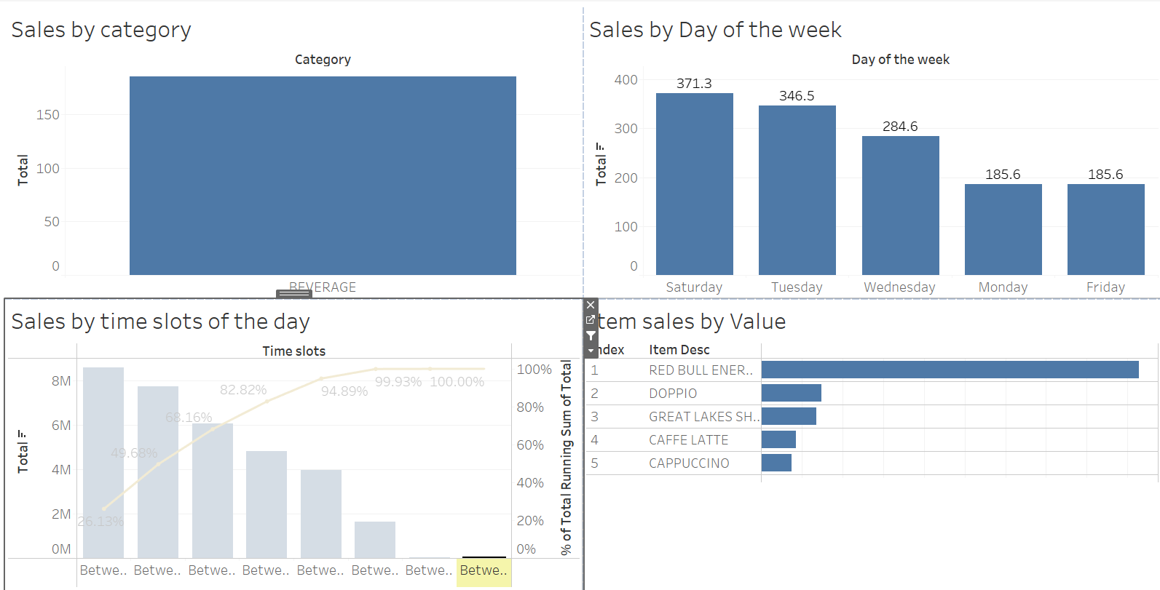
Trends continued…
Food sales are otherwise good but during 6am and 9am i.e., during the breakfast time, the sales haven’t been good. So, need to add some good breakfast items and offers to increase sales during this time
Dashboard #1

Slide 11
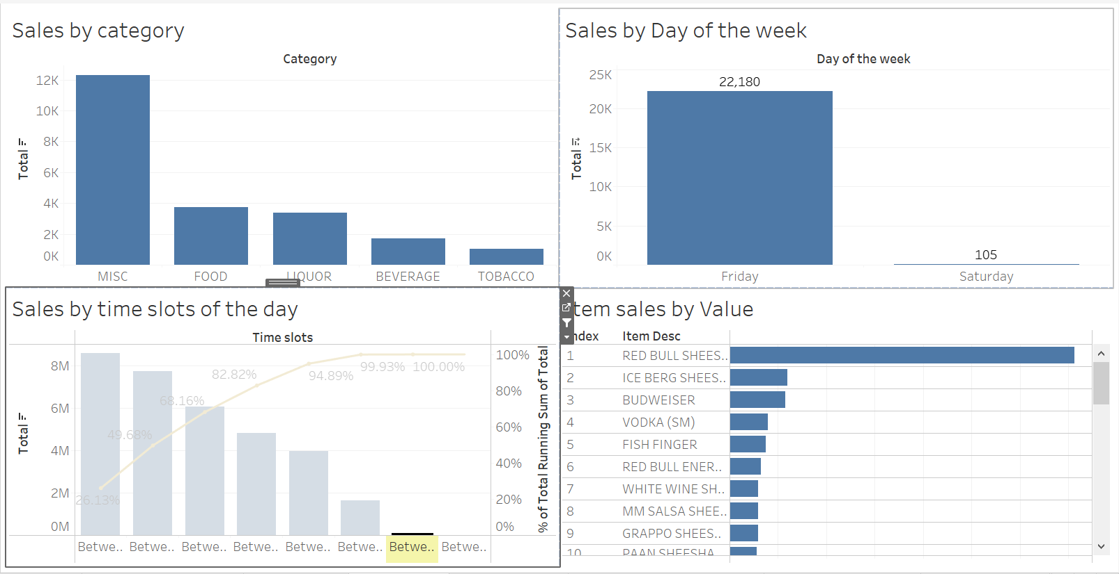
Trends continued…
Dashboard #2

Slide 12
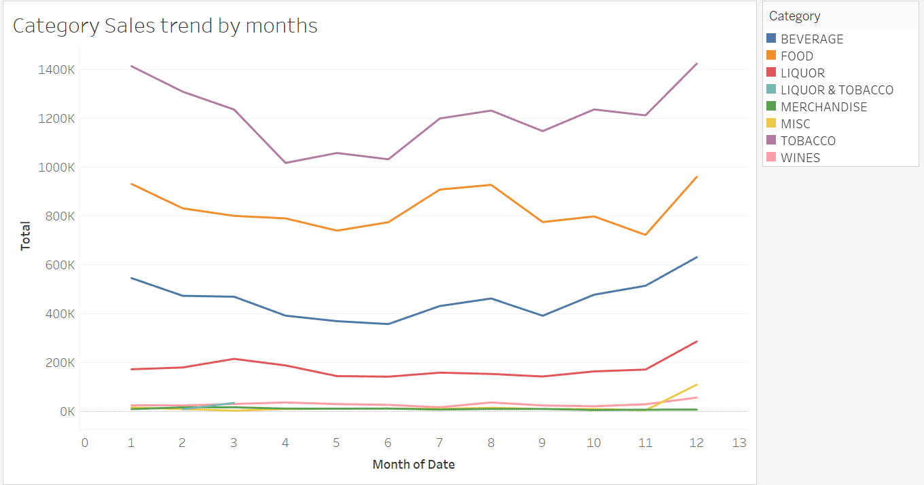
Sales trend by months
About 20% of the total sales is made during December and January. Promotional offers should be maximum during these months
The sales of liquor take pace from November onwards. March onwards till November there isn’t much change in the sales of liquor
There is an increasing trend for the sales of Food, Tobacco, and Beverage from July to August
There is a sharp decline in tobacco sales from March till April

Slide 13
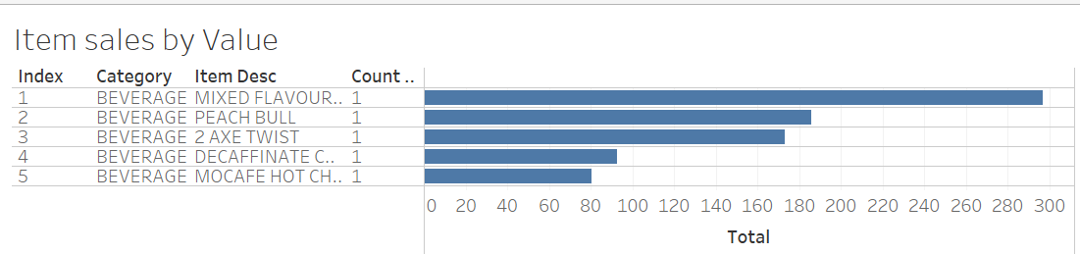
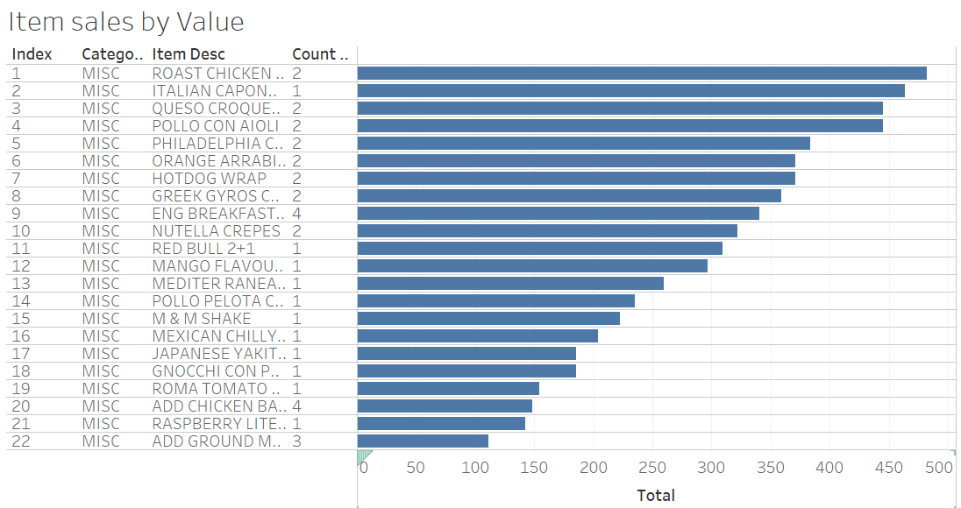
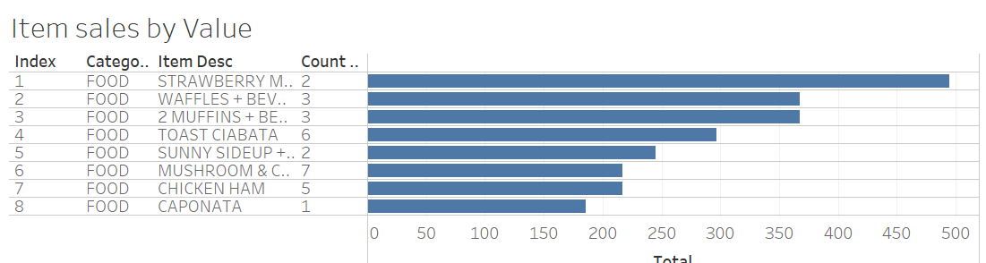
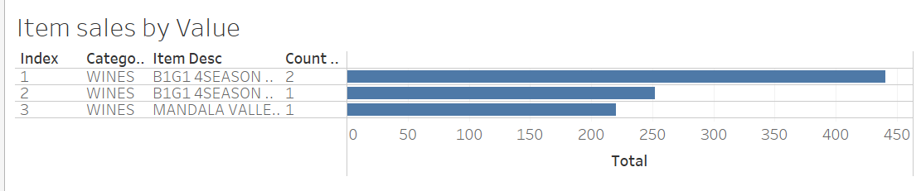
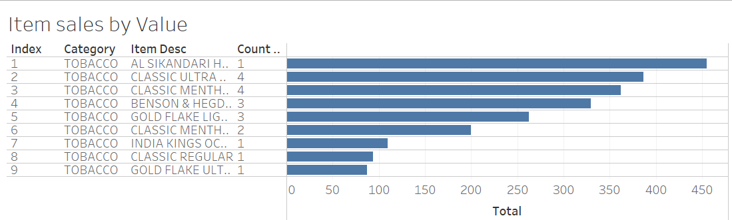
Items to be taken off from Menu for each category
These items have made total annual sales<500. Hence, they should be taken off from the Menu. No such items are from LIQUOR, LIQUOR & TOBACCO category

Slide 14
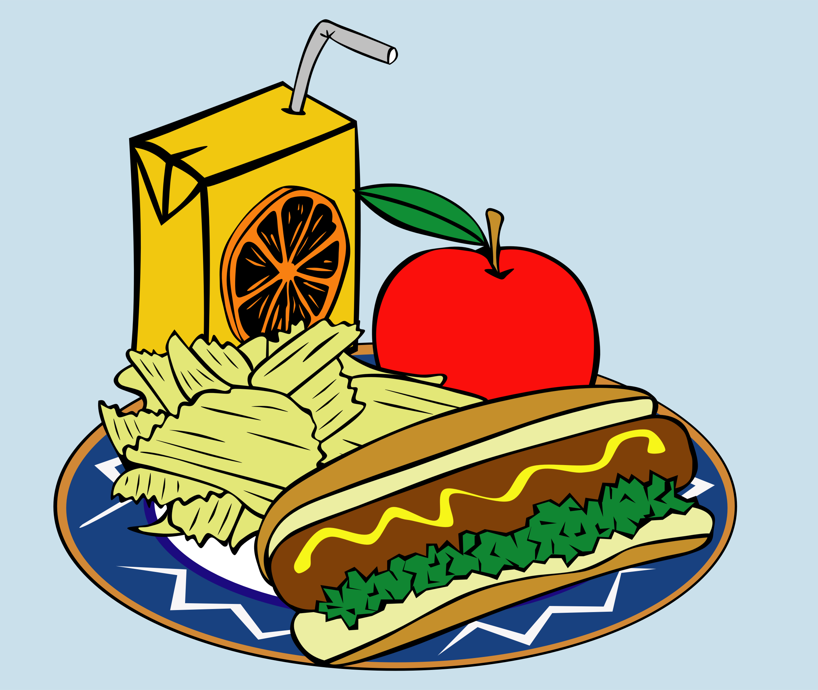
Menu Analysis

Slide 15
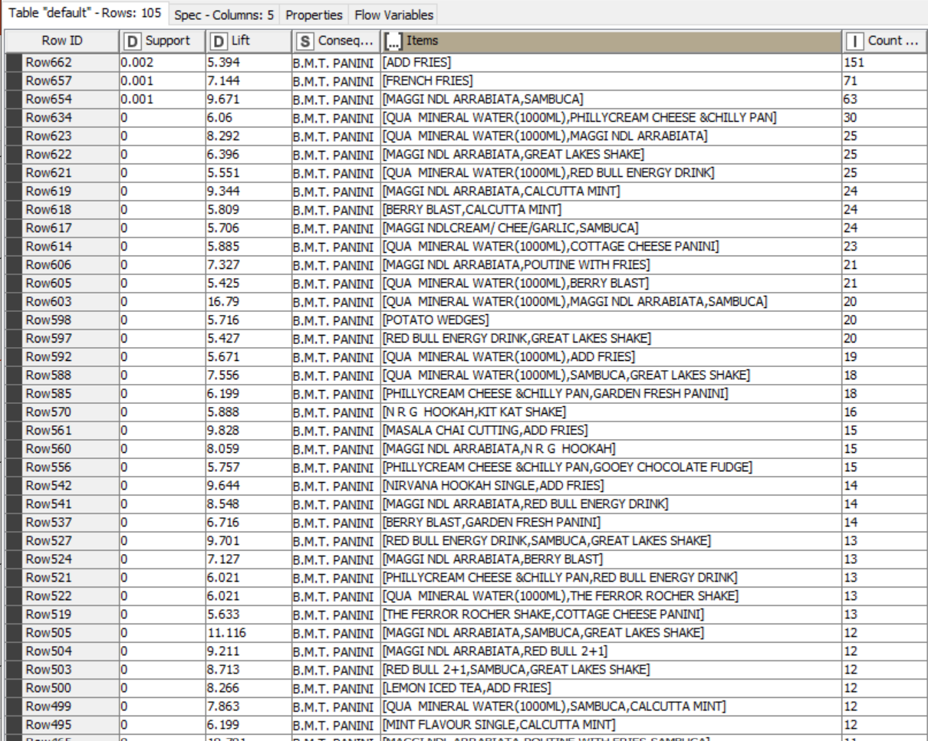
Combo Analysis
There can be 653 total combo suggestions
B.M.T Panini can be a part of 105 combos. It is recommended to suggest an option of adding fries with every order of B.M.T Panini

Slide 16
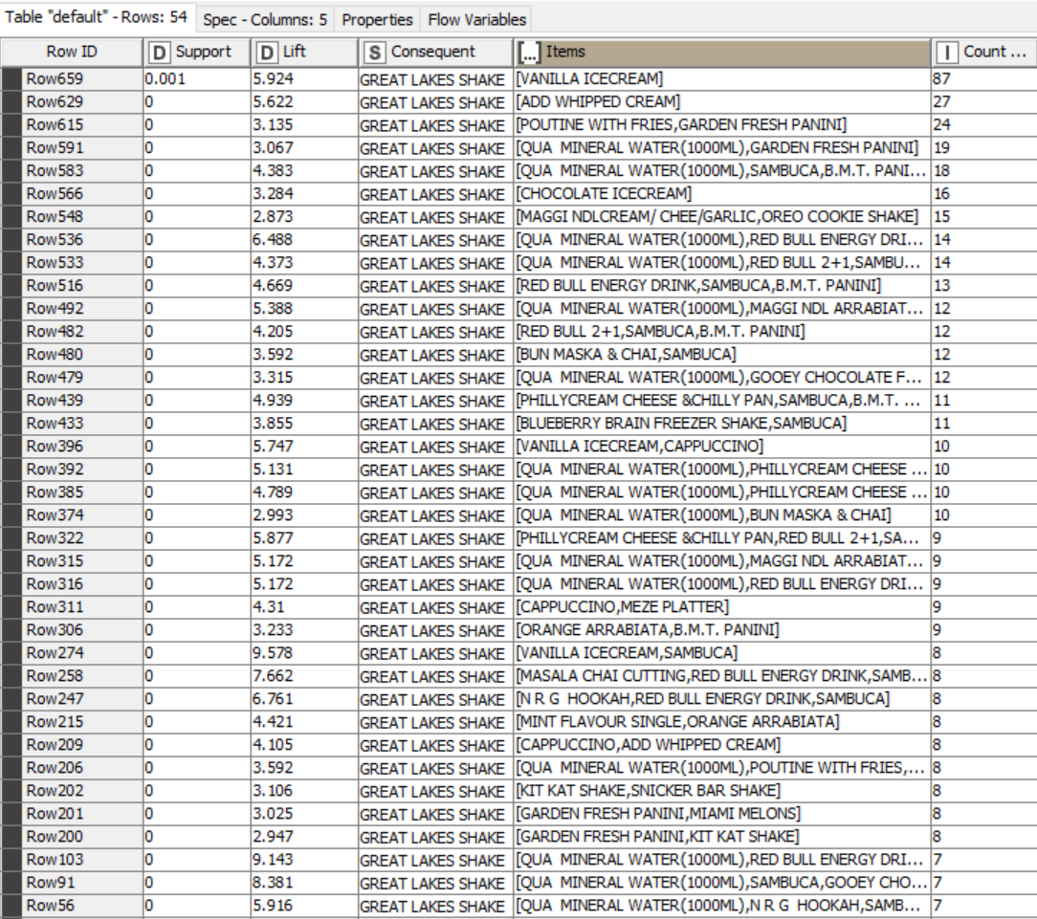
Great lakes shake can be a part of 54 combos. It is recommended to suggest an option of adding vanilla ice-cream and/or adding whipped cream with every order of Great lakes shake

Slide 17
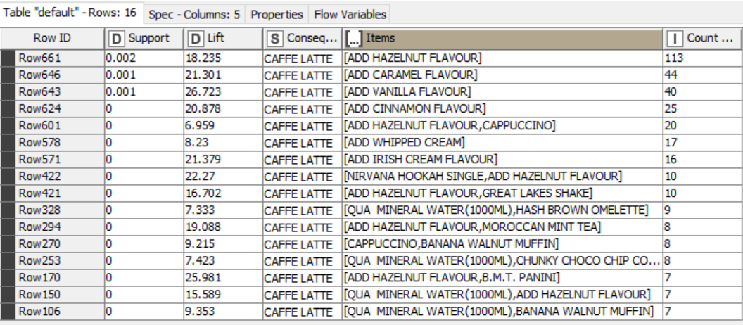
Caffe Latte can be a part of 16 combos. It is recommended to suggest an option of adding hazelnut flavour and/or adding caramel flavour with every order of Great lakes shake

Slide 18
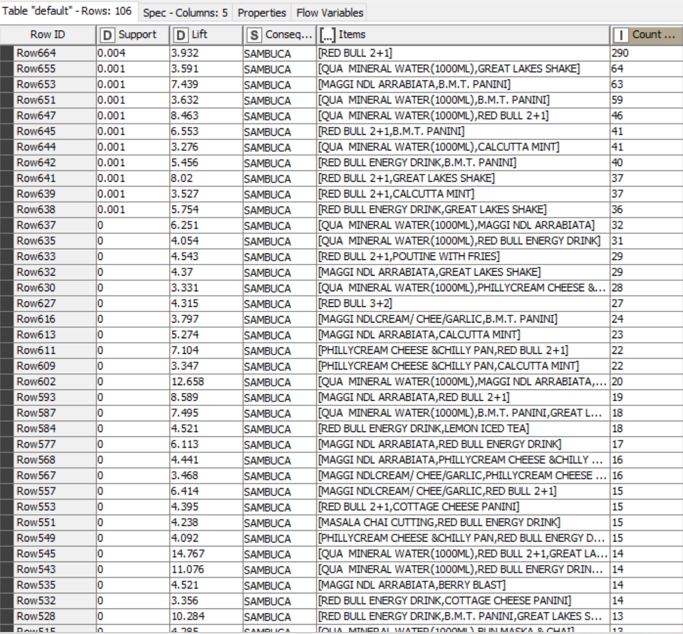
Sambuca can be a part of 106 combos. It is recommended to suggest an option of adding Red bull(2+1) or (3+2) with every order of SAMBUCA

Slide 19

Recommendations

Slide 20
Customers prefer this café during party times in the evening. It would be beneficial to run “Happy hours” offers during the time period of 6pm – 10pm on weekends
59 items should be taken off the menu as their total annual sales is not even 500
Consumers prefer to have caffeine during 6am – 9am. Only beverages are being sold during this time with Red bull in majority. It could be beneficial to run an offer of Red Bull 2+1 or Red Bull 3+2 during this time.
Sales are being made between 3am and 6am on Friday and Saturday only. Maybe the store remains closed on other days. If not, some offers must be run on Sheesha products as they are being sold in majority
Food sales are otherwise good but during 6am and 9am i.e., during the breakfast time, the sales haven’t been good. So, need to add some good breakfast items and offers to increase sales during this time
Top Combos recommended:
BMT Panini with Fries
Great lakes shake with vanilla flavoured ice-cream
Great lakes shake with whipped cream
Café latte with hazelnut flavour
Sambuca with Red Bull 2+1

Slide 21


